Slide 1
GitHub for BAS479
By Allen Pannell
Content @github.com/rabidvol/BAS479

Slide 2
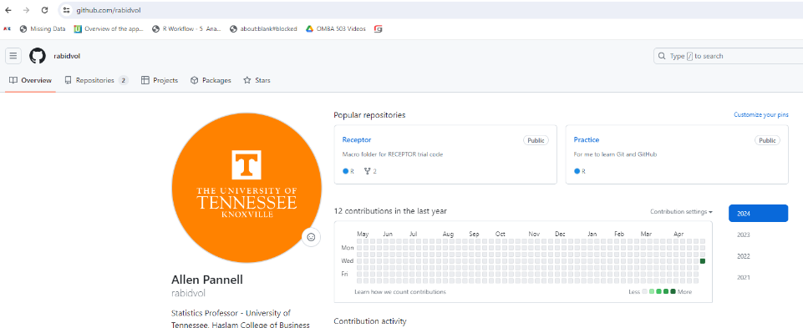
Using GitHub for Version Control and Project Documentation When Using RStudio
For Simple Minded People Like Me

Slide 3
Objective
Get you capable of using GitHub to interact with Rstudio such that you can:
Meet the requirements of this class
Create and manage a project folder (repo) on GitHub
Implement version control for your project/documents
Switch back and forth from Rstudio to GitHub easily
The rest is up to you

Slide 4
Agenda
What is GitHub?
What will we use GitHub for?
Make GitHub Account
Download GitHub Desktop
Find my GitHub Repo for this class
What is a Repo?
Set up your own Repo for this class
Post and edit code to GitHub utilizing Rstudio
Collaboration with classmates

Slide 5

What is GitHub?
A website
Cloud storage
Cloud Server
Integration tool with Git and other software
See
Daniel Shiffman
@shiffman

Slide 6
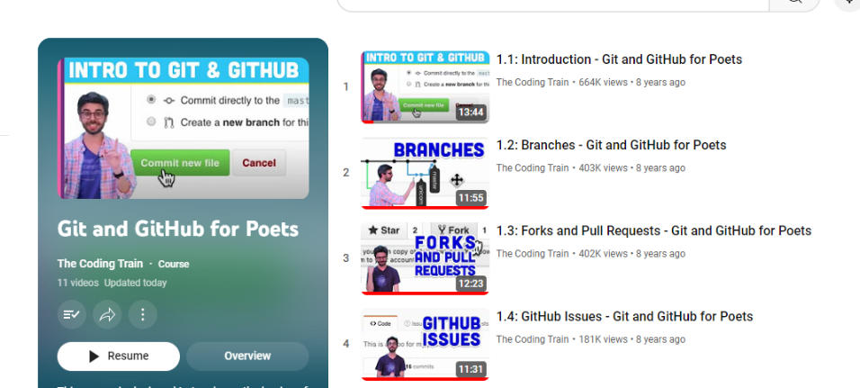
https://www.youtube.com/@TheCodingTrain

Slide 7
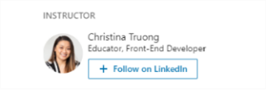
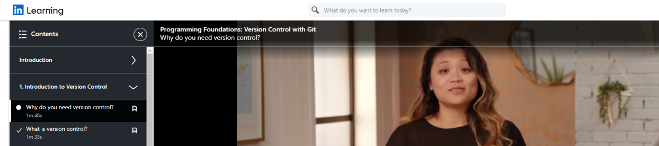
What will we use GitHub for?
Project Folder for file organization
Collaboration for teamwork
Version Control for files
See Christina on LinkedIn Learning
First few videos of this course

Slide 8
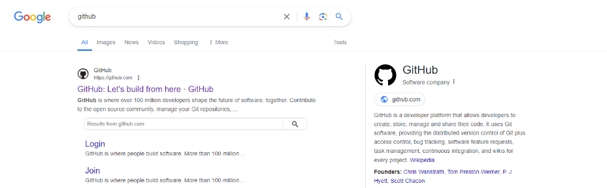
Let’s Make a GitHub Account

Slide 9
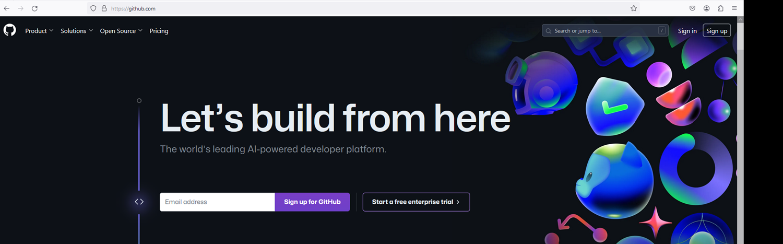

Let’s Make a GitHub Account
Consider using your personal email since UTK will expire. Doesn’t matter for our class

Slide 10
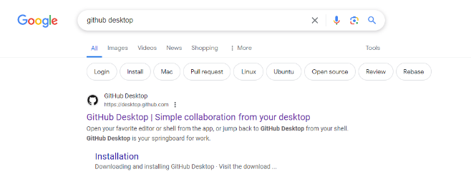
Download GitHub Desktop

Slide 11
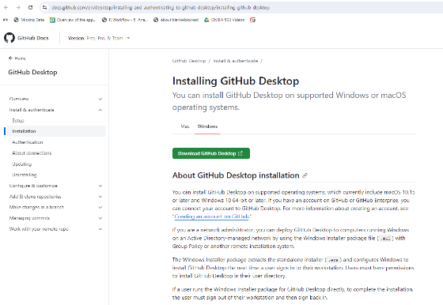
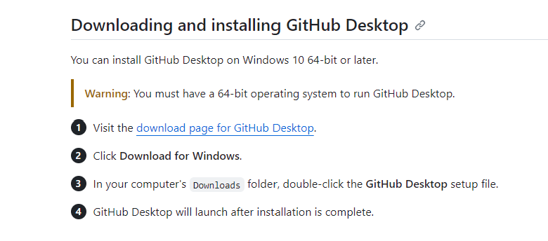
Download GitHub Desktop

Slide 12
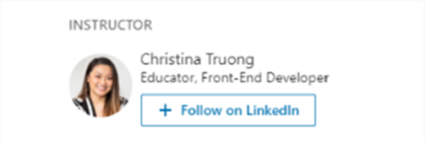
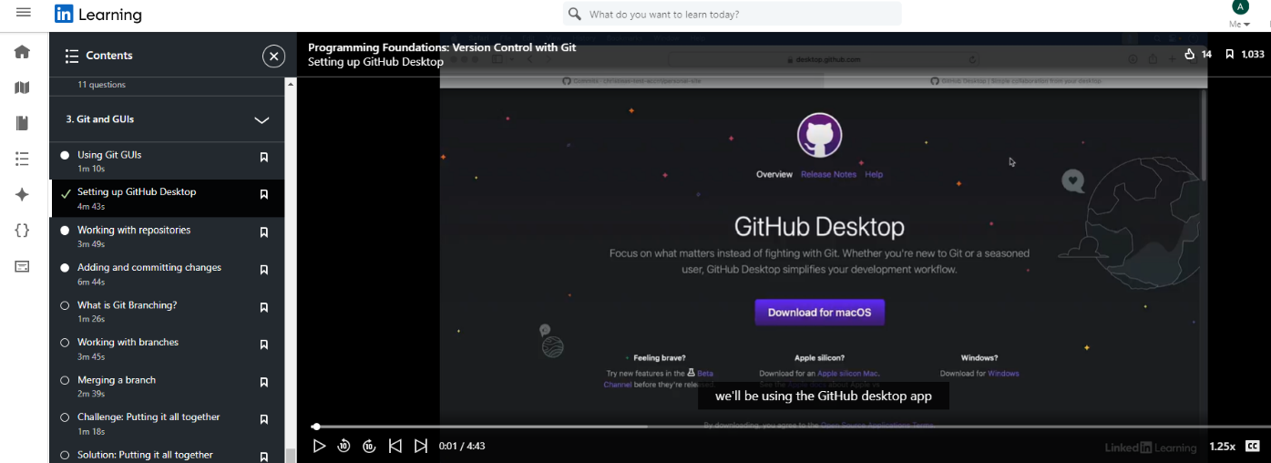
Video Help. Back to Christina’s course

Slide 13
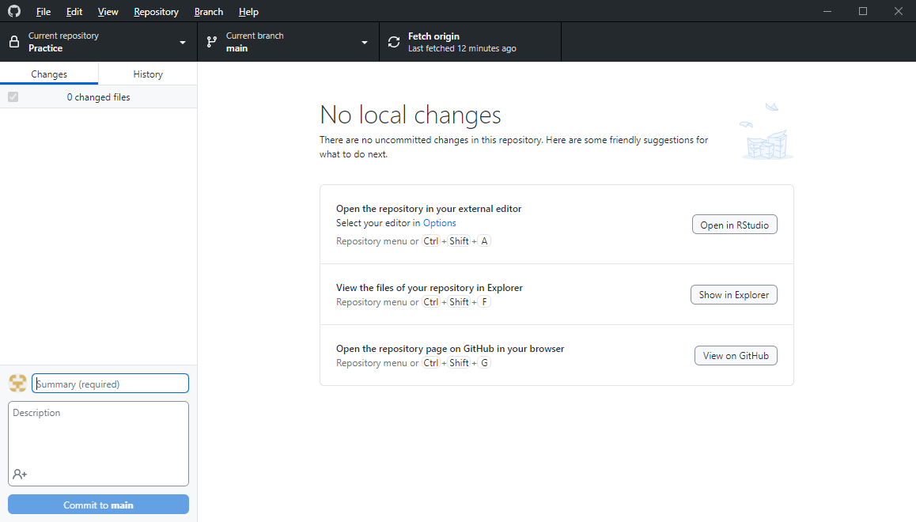
What Desktop Looks like …. after syncing with GitHub.com

Slide 14
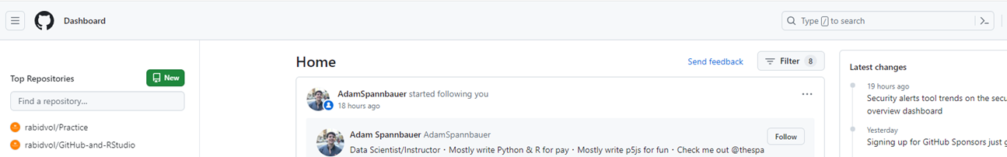
Find my GitHub Repo for your class
Logon to GitHub.com
Got to search bar on your Home page:
Type ‘rabidvol/BAS479’ (or your class number)

Slide 15

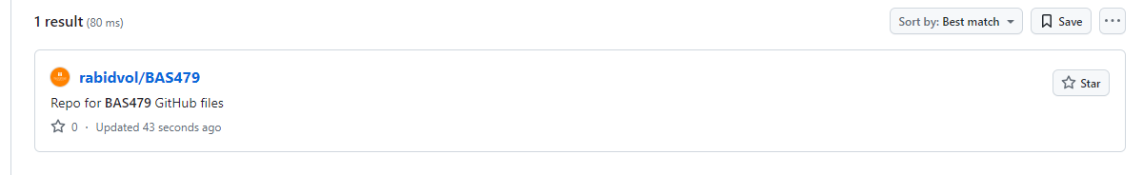
Find my GitHub Repo for your class
Click Here

Slide 16
What is a Repo?
Think of a master folder on:
Dropbox
Google Drive
One Drive
Inside the master folder (Repo) are
Files of any type
Mainly your R files
Subfolders to organize your work
Creating one is easy

Slide 17
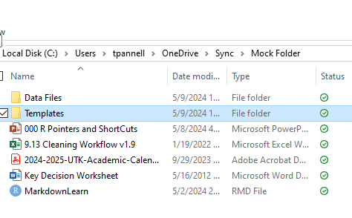
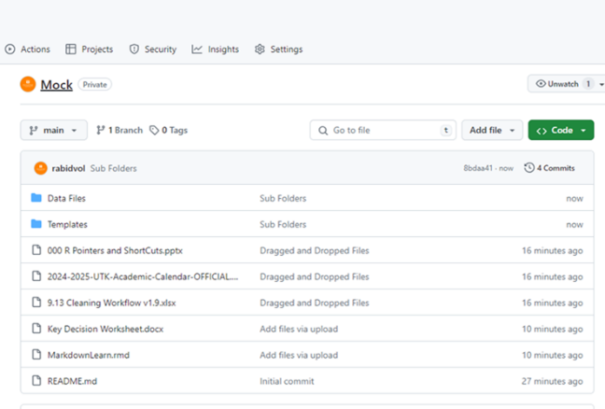
What is a Repo?
My folder on One Drive
My Repo with same files

Slide 18
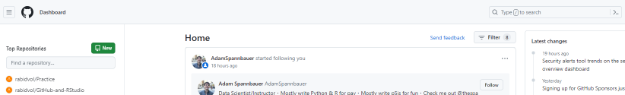
Creating a Repo on GitHub.com
From your Home Page, select New

Slide 19
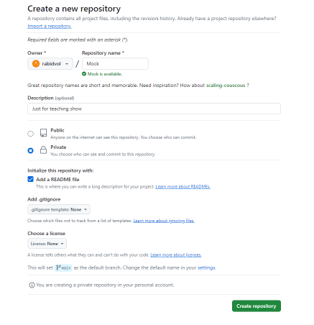
This Screen Will Appear
Name, can’t use spaces

Slide 20
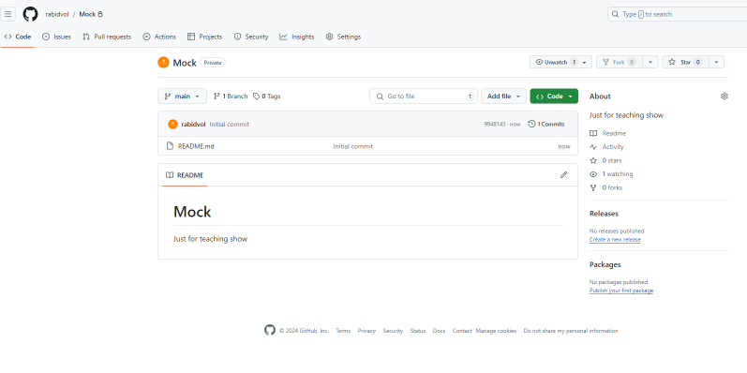
Voila!!!!

Slide 21
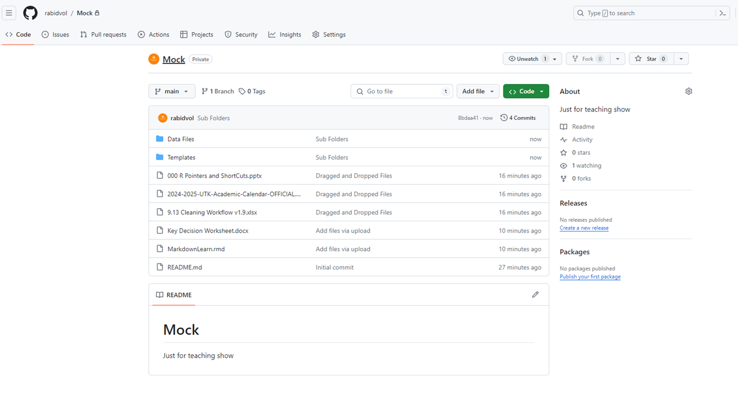
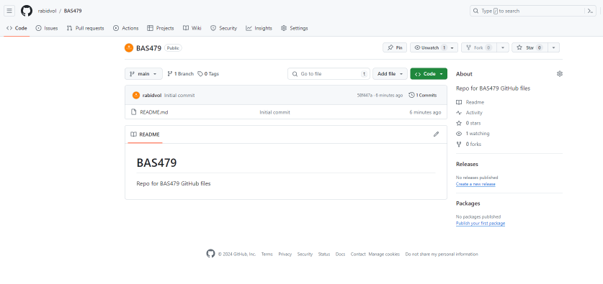
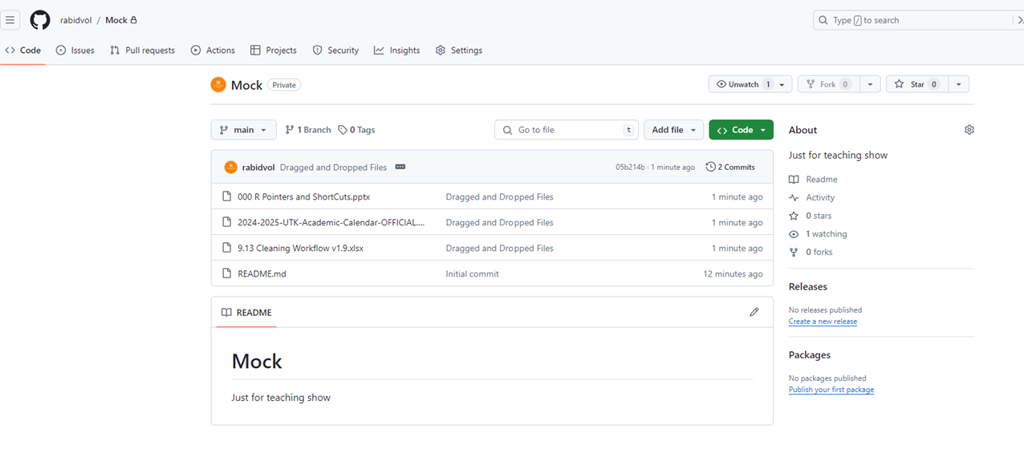

View will change over time

Slide 22
Set up your own Repo for this class
One Team Member (designated leader on Canvas if appropriate) creates the repo and then invites their other team members

Slide 23
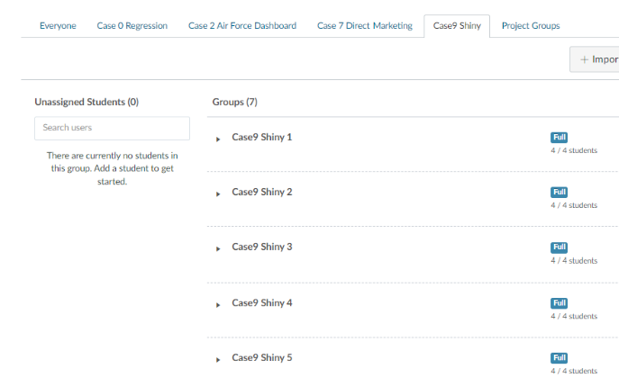

Now Make Your Repo
Start Name with class name (BAS479)
Then add your Canvas Group Name
(e.g. Case9Shiny1)
So your Repo name would be
BAS479Case9Shiny1

Slide 24
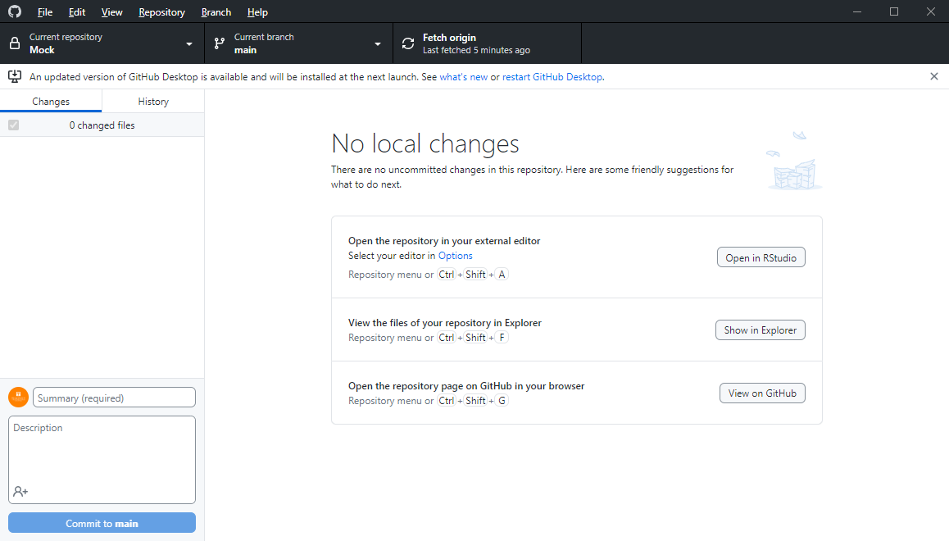
Now Let’s Start Working with GitHub Desktop
Open Desktop if it is not already
I’m assuming you have connected it to your GitHub.com account
It will look something like this, probably with no Repo open:

Slide 25
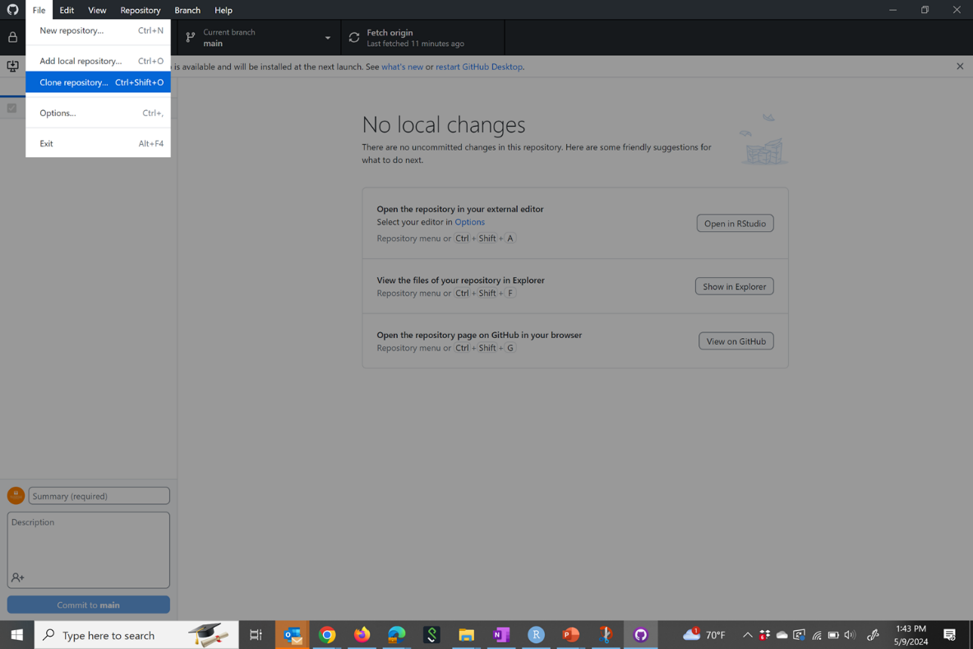
Now Let’s Connect your Desktop to the Cloud Repo

Slide 26
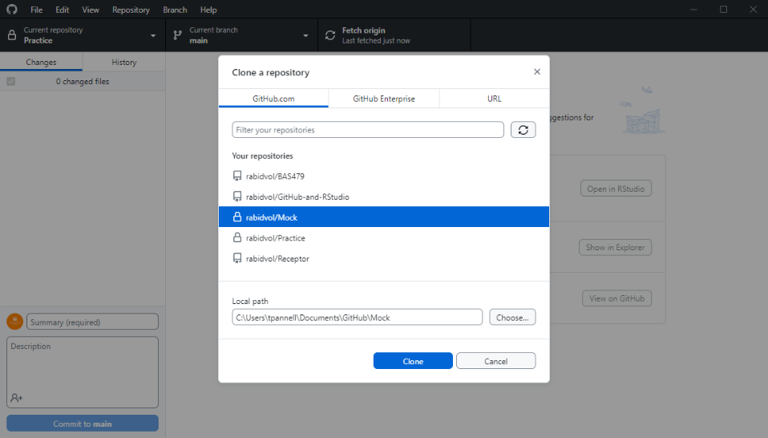
Then Choose Your Repo … click clone

Slide 27
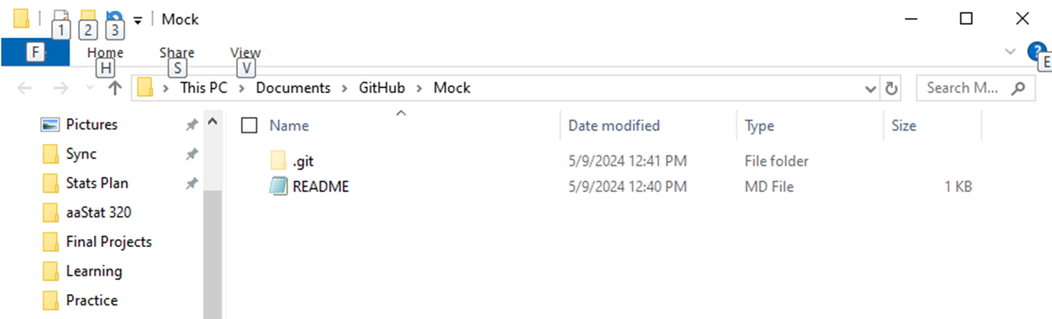
This Creates a Local Folder that Looks and Feels Like What we Do Every Day

Slide 28
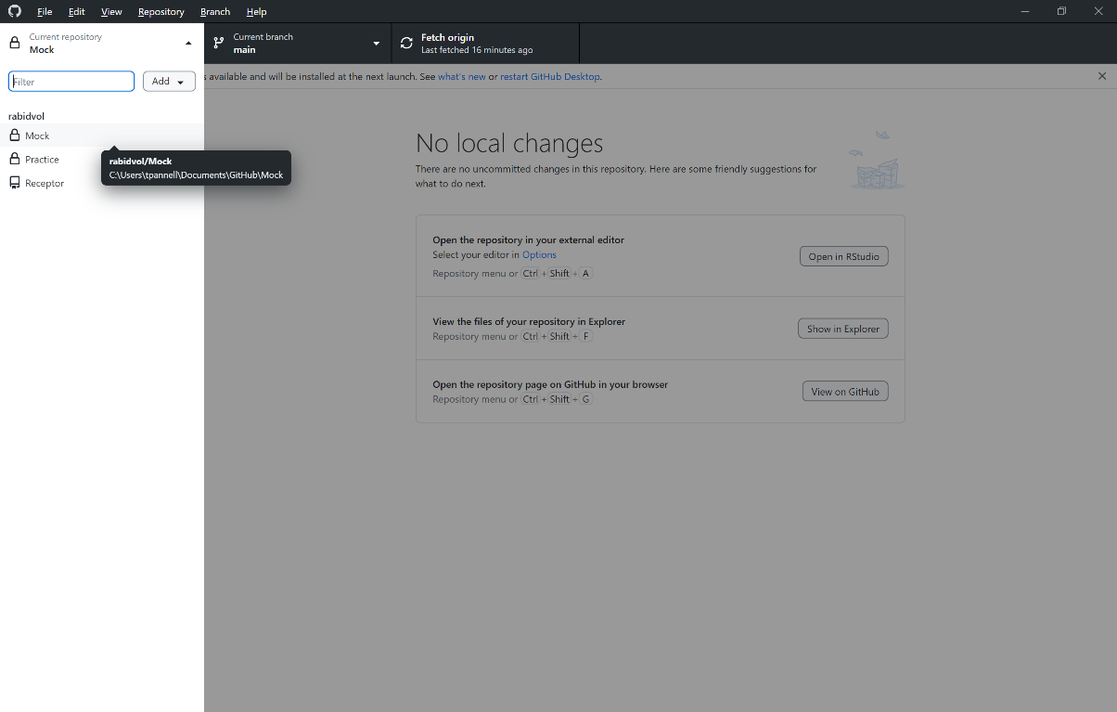
Choose the Repo You Want to Work with on the Desktop

Slide 29
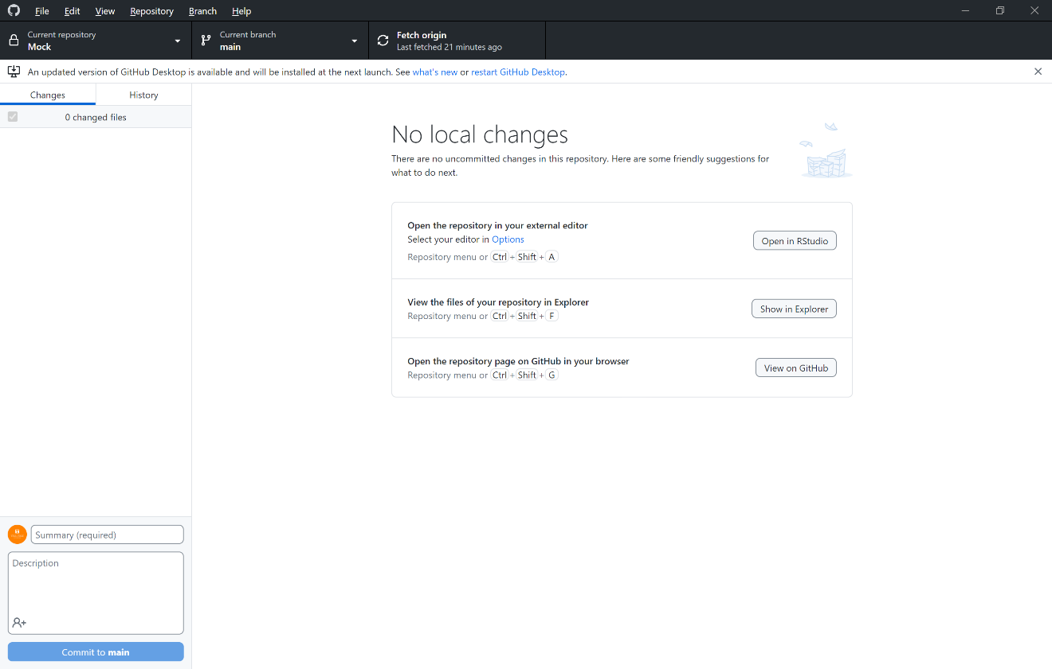
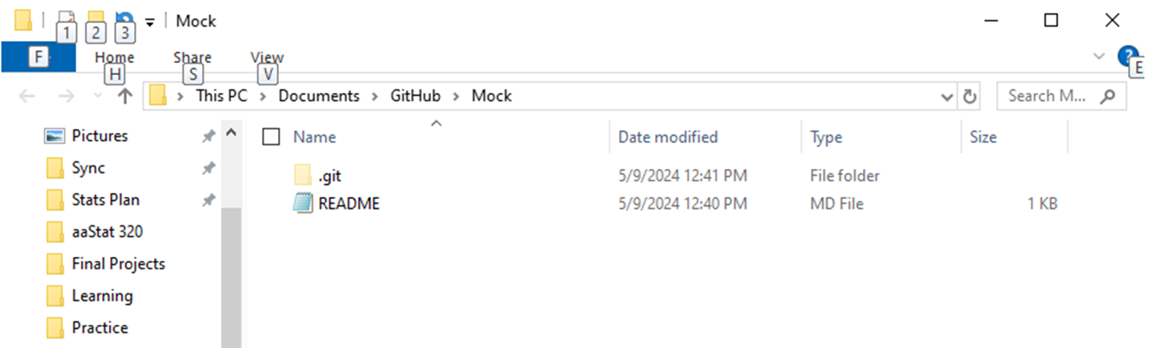
Now We Can Add Files (will show via Desktop and Cloud)

Slide 30
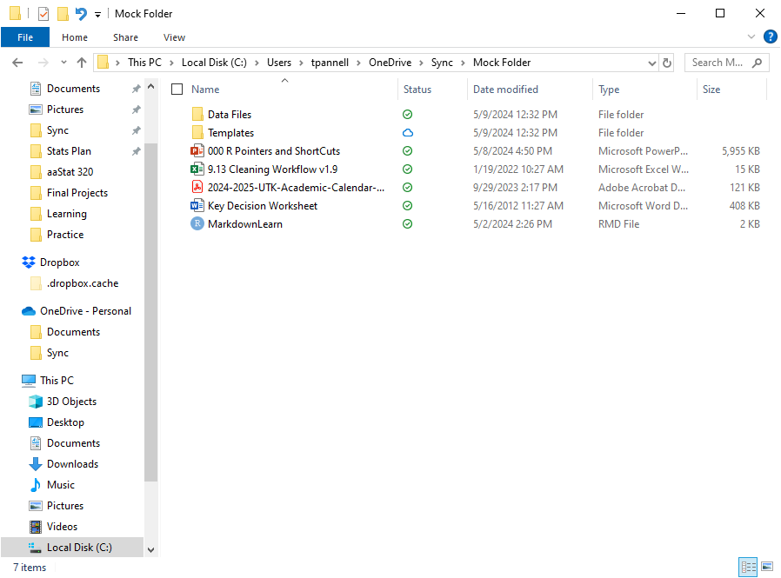
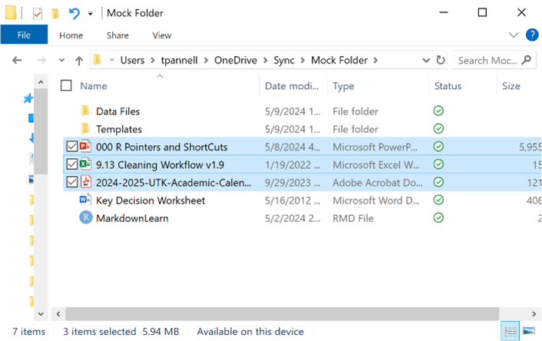

Let’s Say I have some files already

Slide 31
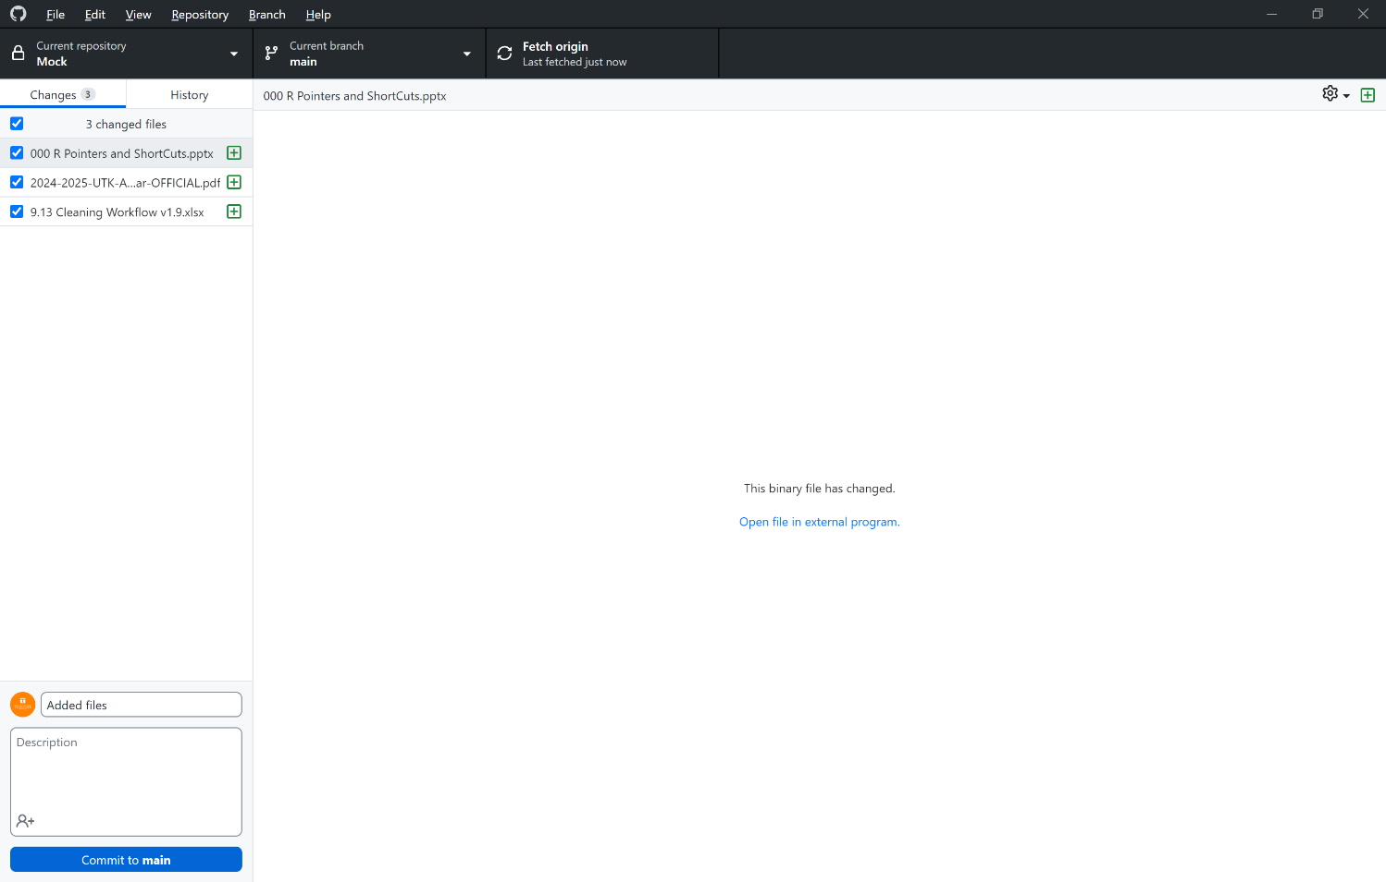
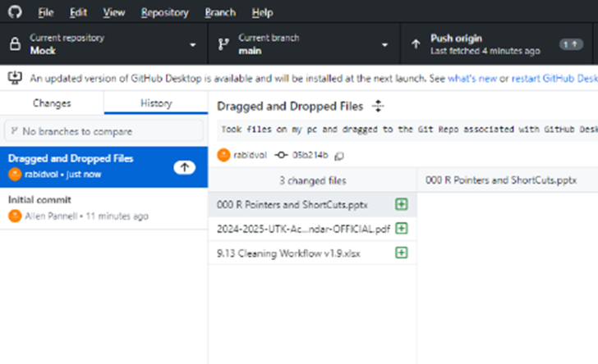
After Drag and Drop, go to Desktop

Slide 32
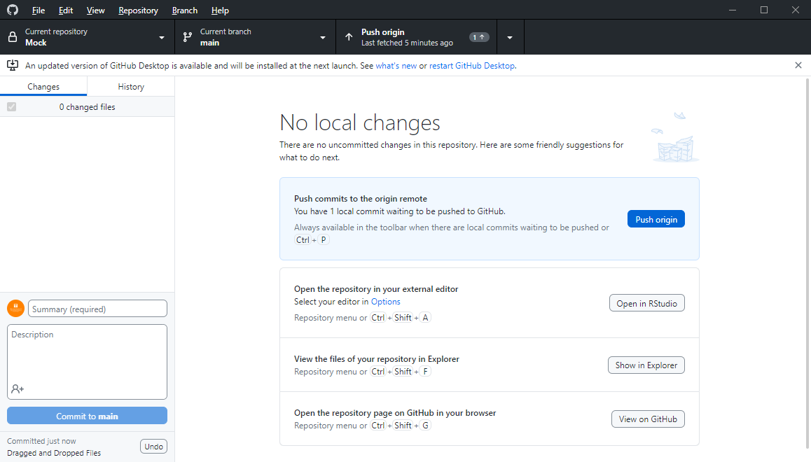

Now You are Reminded to Push to Cloud

Slide 33
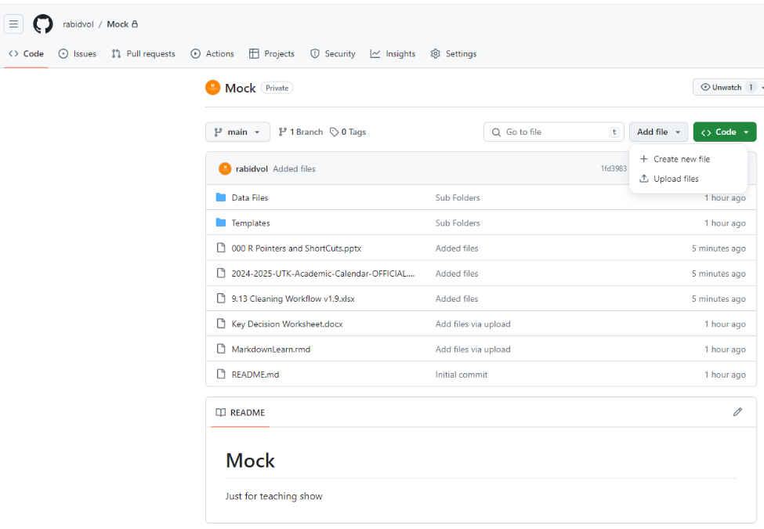
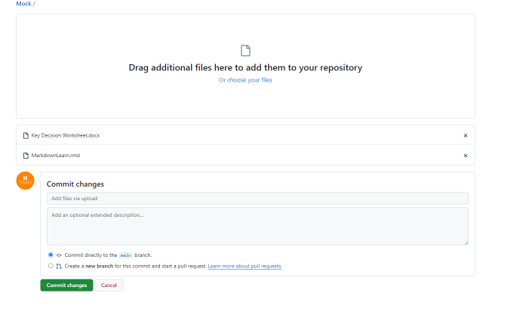
Can Drag or Upload Files On-Line

Slide 34

Whew!!!
This Photo by Unknown Author is licensed under CC BY-NC

Slide 35
Post and edit code to GitHub utilizing RStudio
This is the main reason we are here
Sure was a lot of work to get here, but it will be worth it
************* When editing R files, the ONLY way we are going to learn how is with:
GitHub Desktop
DON’T try this on GitHub.com until you are on your own.

Slide 36
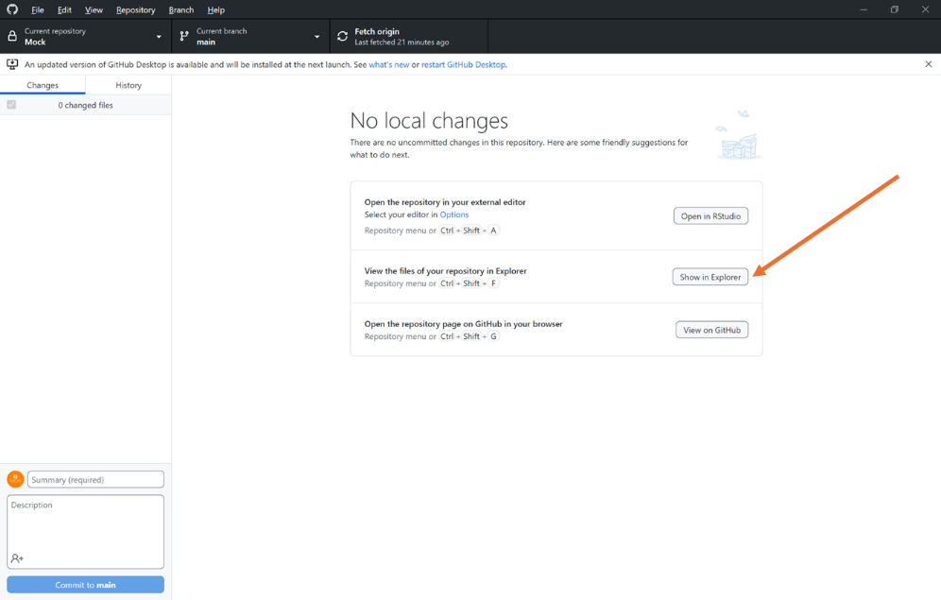
By Now, I assume you can upload/drag some R code to GitHub
Can be any format
.r
.rmd
.r(shiny)

Slide 37
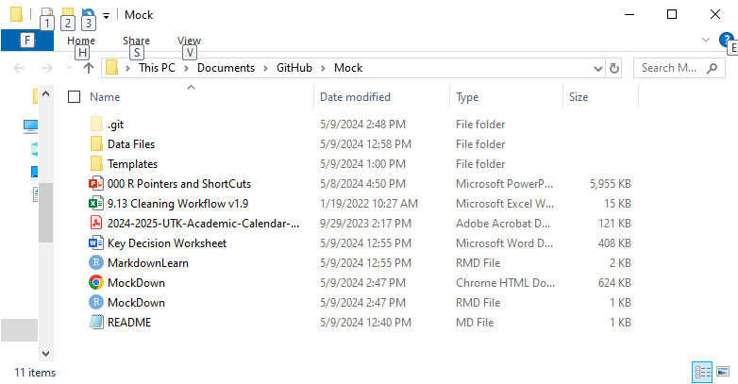
Just Click on the file like you normally would

Slide 38
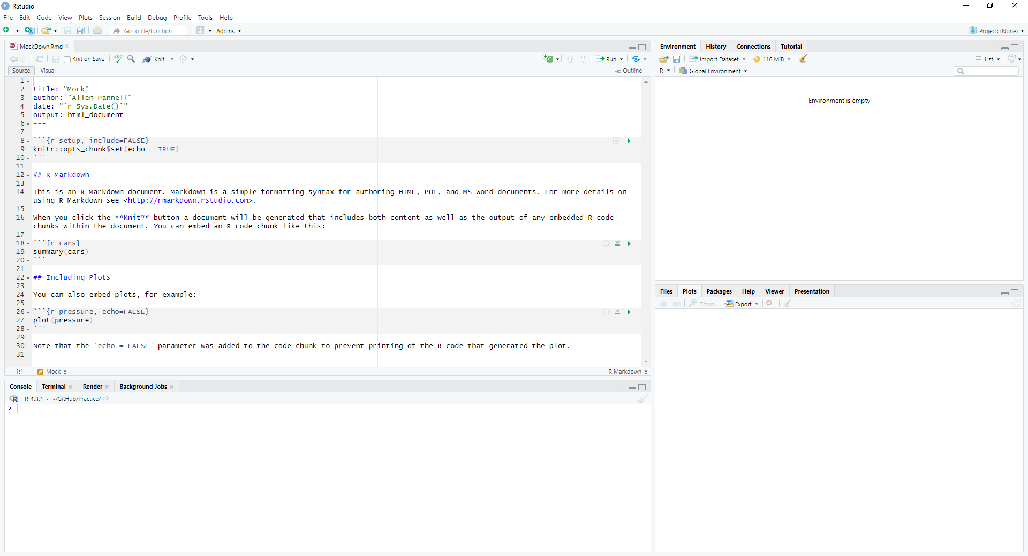
MockDown now open in RStudio

Slide 39
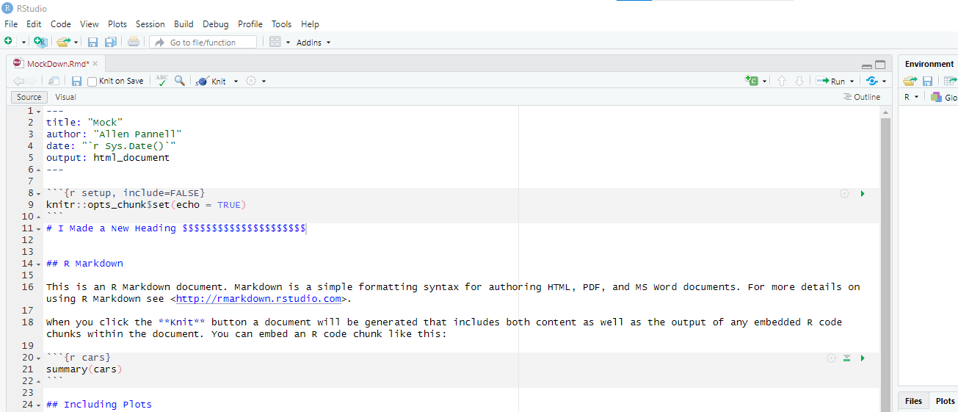
Make Some Changes and Knit

Slide 40
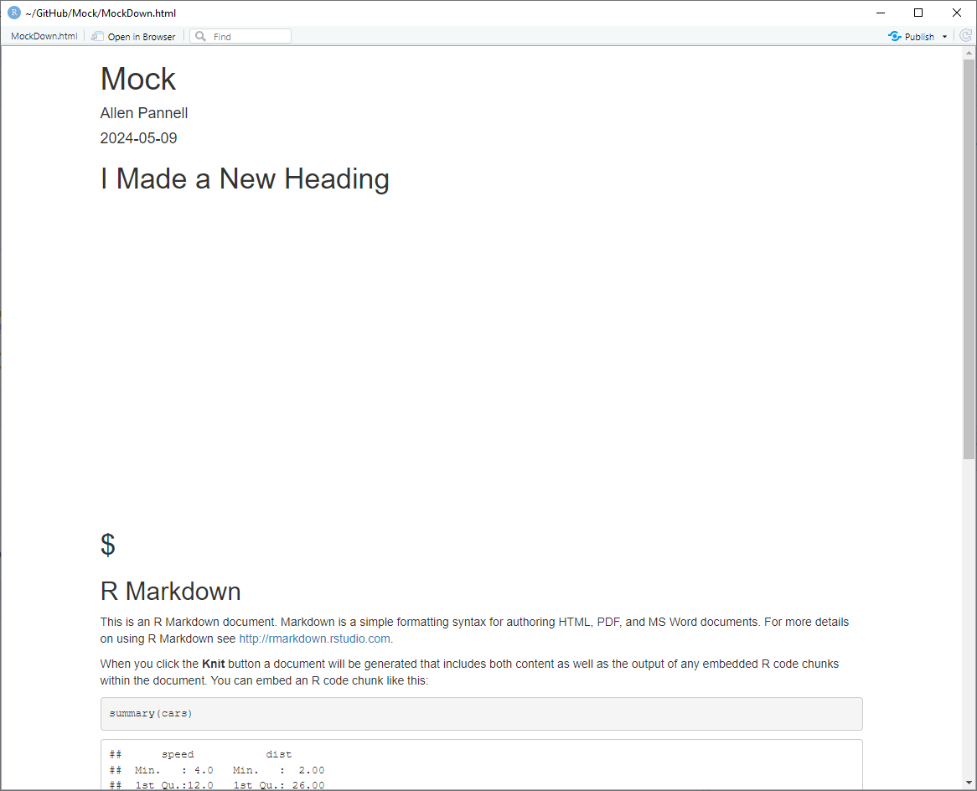
Make Some Changes and Knit

Slide 41
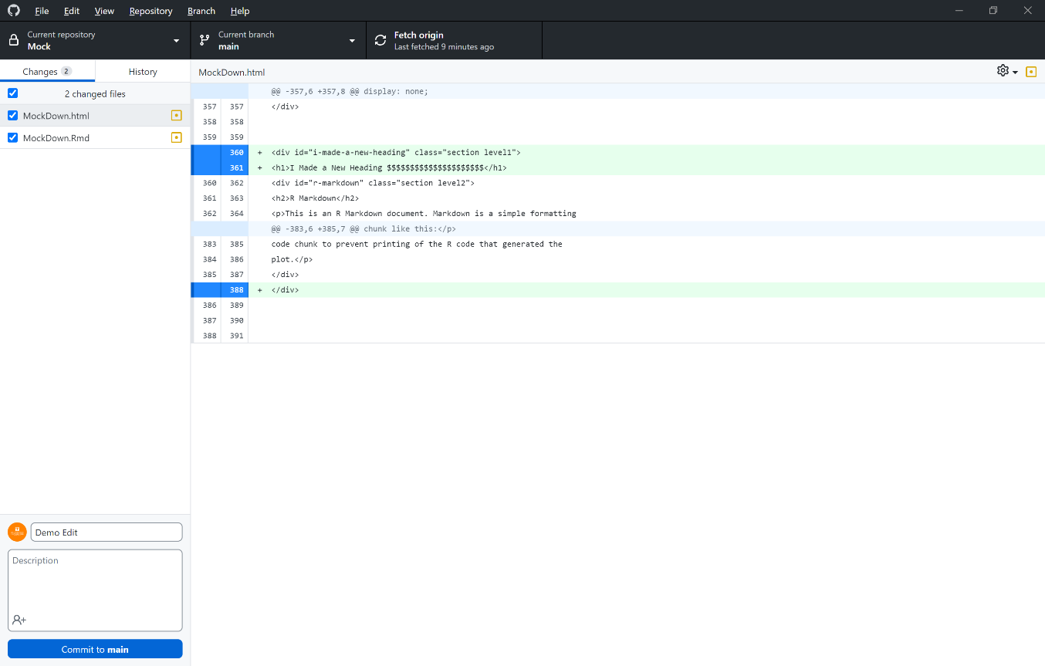
GitHub Desktop knows I saved (when knitted) and makes a commit. Yea!

Slide 42
Collaboration
Add People to your Repo
Allow them to make changes
Monitor changes at a certain level of detail

Slide 43
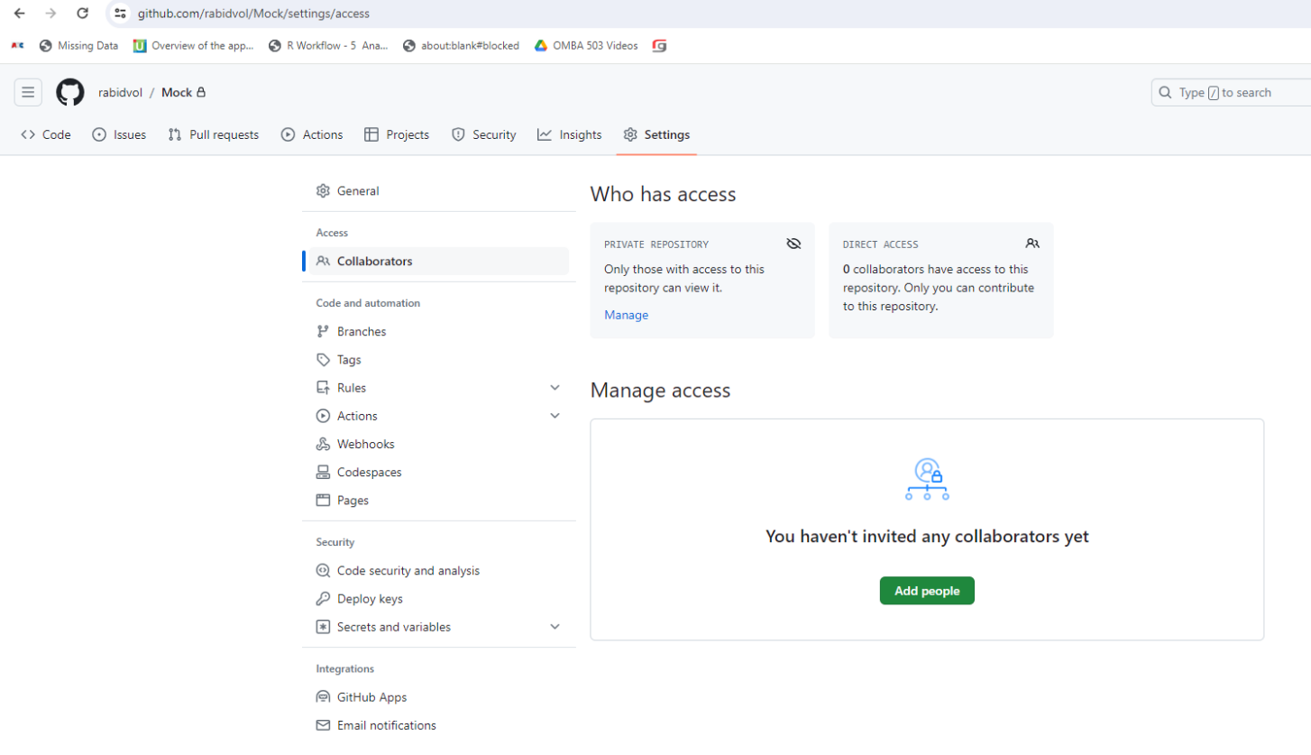
Collaboration (GitHub.Com)

Slide 44
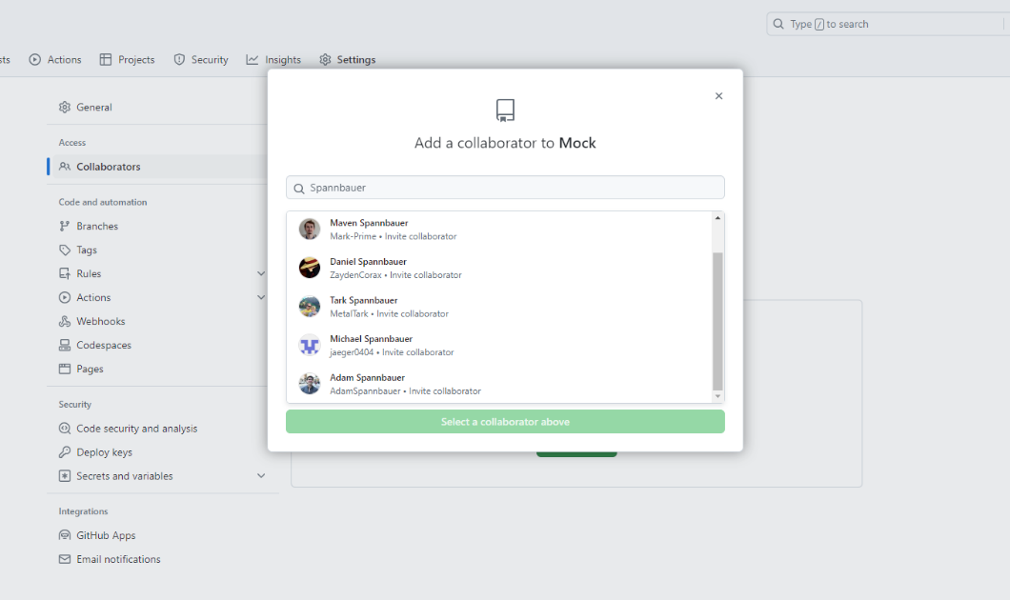
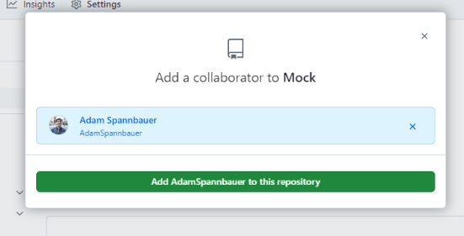
Collaboration (GitHub.Com)

Slide 45
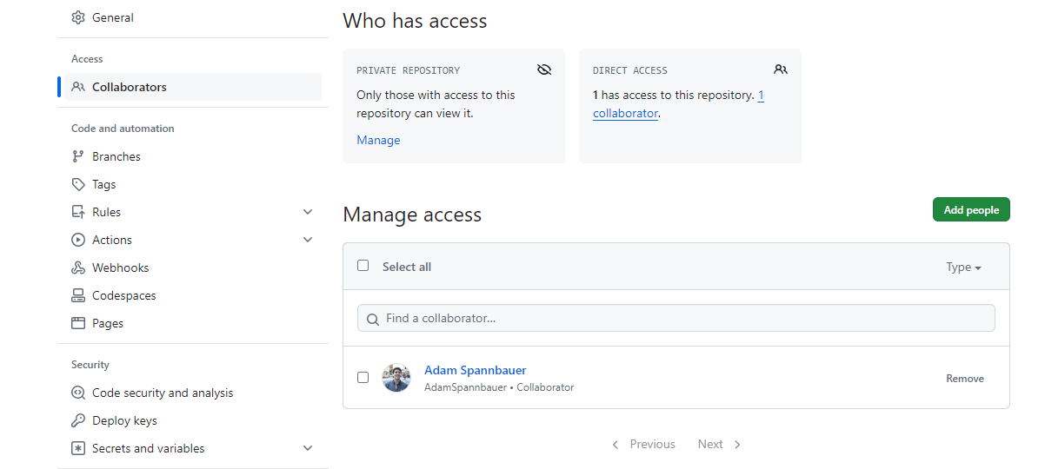
Collaboration (GitHub.Com)

Slide 46
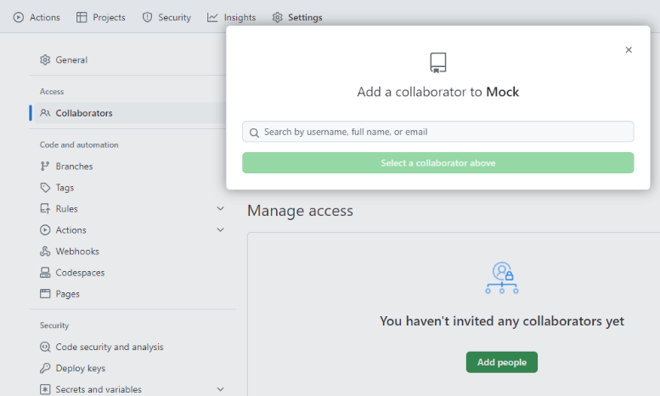
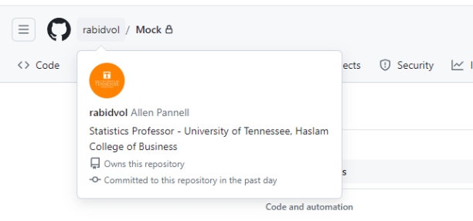
Collaboration (Add Me First)

Slide 47
Collaboration (Now add your team)

Slide 48
Make sure to study these concepts in the videos.
Commit
Branch
Fork
Pull
Issues

Slide 49
You are ready to go.
The beginning of….
The End

